Slide 1
A STACKED ENSEMBLE LEARNING MODEL FOR ENHANCED NETWORK INTRUSION DETECTION
Authors:
Vishnu Menon
Dr. Lakshmi Harika Palivela

Slide 2
CONTENTS
INTRODUCTION
PROBLEM STATEMENT
RESEARCH OBJECTIVE
PROPOSED SYSTEM
CONCLUSION
REFERENCES

Slide 3
INTRODUCTION
In the rapidly evolving landscape of cybersecurity, the persistent and ever-adapting threat of intrusions poses a formidable challenge to organizations safeguarding their digital assets. Traditional Intrusion Detection Systems (IDS), employing signature-based and anomaly-based methodologies, often struggle to keep pace with the sophistication of modern cyber threats. The limitations of these conventional approaches, including high false positive rates and difficulties in adapting to novel attack patterns, underscore the need for innovative solutions. This introduction sets the stage for a closer examination of a groundbreaking approach – the integration of meta-learners into intrusion detection. By leveraging meta-learning techniques, this project seeks to enhance the adaptability and accuracy of intrusion detection systems, providing a more resilient defense against the dynamic and evolving landscape of cyber threats in today's digital environments.

Slide 4
PROBLEM STATEMENT
In the realm of cybersecurity, the increasing sophistication of cyber threats poses a substantial challenge to conventional intrusion detection systems (IDS). Traditional IDS solutions often struggle to adapt and evolve in real-time to counter novel and complex attacks. As a result, there is a pressing need for innovative approaches to enhance the effectiveness of intrusion detection. One promising avenue is the integration of meta-learning techniques into the design and deployment of IDS, aiming to create systems that can learn and adapt dynamically to emerging threats.

Slide 5
RESEARCH OBJECTIVES
I. Model Evaluation and Selection
a. Base Classifier Comparison: Evaluate and compare the performance of a variety of base classifiers on the given dataset, considering metrics such as accuracy, precision, recall, and F1 score.
b. Identification of Top Three Classifiers: Determine the best-performing three base classifiers based on the comprehensive evaluation, selecting those with the highest overall performance.
II. Meta-Classifier Integration
a. Meta-Classifier Training: Implement a meta-learning approach to train meta-classifiers using the outputs of the selected top three base classifiers. Explore techniques such as stacking or ensemble methods to create robust meta-classifiers.
III. Combination Strategy Exploration
a. Combination of Meta and Base Classifiers: Investigate various combinations of the selected meta-classifiers and base classifiers to create ensemble models.
b. Performance Comparison of Combinations: Evaluate and compare the accuracies of the ensemble models created by combining meta and base classifiers. Analyze the impact of different combinations on overall classification performance.

Slide 6
PROPOSED SYSTEM
In response to the escalating sophistication of cyber threats, this proposed Intrusion Detection System (IDS) leverages ensemble-learning to create a highly adaptive and responsive cybersecurity solution. Through a systematic approach involving the evaluation and selection of optimal base classifiers, the system integrates them into a meta-learning framework. This unique amalgamation aims to enhance the IDS's ability to swiftly learn and counter emerging threats, addressing challenges such as limited labeled data, dynamic threat adaptability, and computational efficiency. Ultimately, this meta-learning-based IDS seeks to redefine cybersecurity standards by offering heightened accuracy, adaptability, and interpretability in the face of evolving cyber threats.

Slide 7
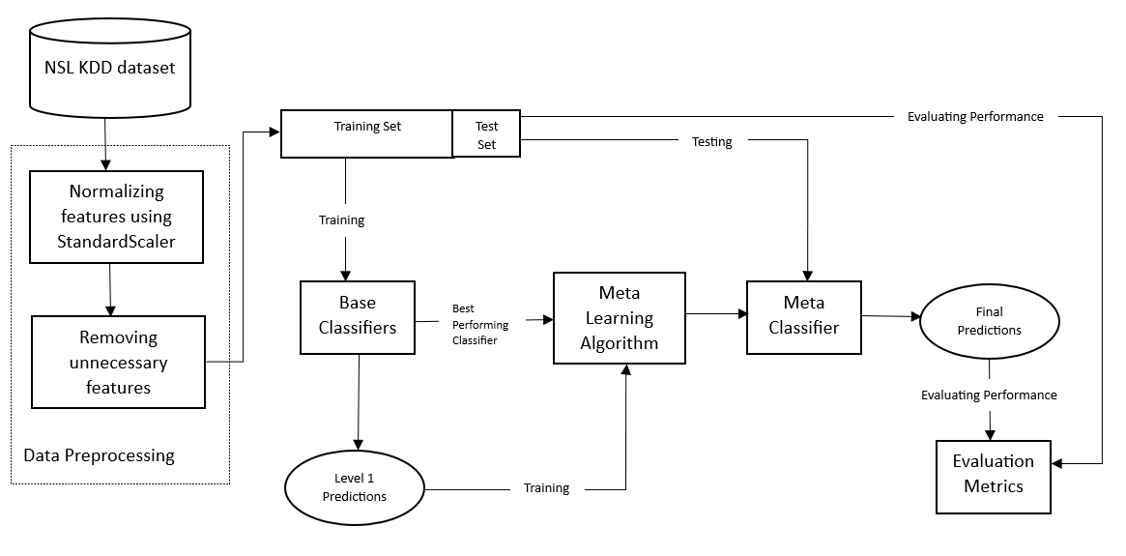
ARCHITECTURE DIAGRAM

Slide 8
MODULES
Base Classifier Evaluation Module:
Functionality: Evaluate and compare various base classifiers (e.g., Decision Trees, Perceptron).
Protocol: Utilize metrics such as accuracy, precision, recall, and F1 score for evaluation.
Meta-Classifier Integration Module:
Functionality: Train meta-classifiers using outputs from the top three base classifiers (e.g., stacking, ensemble methods).
Combination Strategy Exploration Module:
Functionality: Investigate combinations of meta and base classifiers to create ensemble models.

Slide 9
ALGORITHM
Input: NSL-KDD dataset
Output: Enhanced accuracy and stronger model
Step 1: Data Preprocessing
1. If (feature has high correlation) do the following: Drop feature
2. Apply StandardScaler()
3. Apply LabelEncoder() /* Convert categorical features to numbers*/
Step 2: Base-classifier
1. Test out different base-classifiers
2. Note down the accuracies in ascending order
Step 3: Meta-classifier
1. Select the 3 best base-classifiers as meta-classifiers
2. Use each meta-classifier individually along with other base-classifiers
Step 4: Trying different combinations
1. Try the following combinations for each meta-classifier:
a. All Base-classifier + Meta-classifier
b. 7 Best Base-classifier + Meta-classifier
c. 5 Best Base-classifier + Meta-classifier
d. 3 Best Base-classifier + Meta-classifier
2. Note down the accuracies in a table
Step 5: Comparative analysis for the ensembled models
Step 6: End

Slide 10
Base Classifier Evaluation Module
Evaluate and compare various base classifiers.
STOCHASTIC GRADIENT DESCENT CLASSIFIER
PERCEPTRON
NAIVE BAYES CLASSIFIER
MULTI-CLASS LOGISTIC REGRESION
DECISION TREE CLASSIFIER
HISTOGRAM-BASED GRADIENT BOOSTING CLASSIFICATION TREE
EXTRA TREES CLASSIFIER
RANDOM FOREST
SVM
KNN
MULTI-LAYER PERCEPTRON
XGBOOST
CATBOOST

Slide 11
Meta-Classifier Integration Module
Functionality: Train meta-classifiers using outputs from the three best base classifiers (e.g., stacking, ensemble methods).
Meta Classifiers selected:
XGBoost
Random Forest
CatBoost

Slide 12
Combination Strategy Exploration Module
Combinations of meta and base classifiers are used to create ensemble models.
Combination 1: All Base Classifiers (RANDOM FOREST, CATBOOST, EXTRA TREES CLASSIFIER, DECISION TREE CLASSIFIER, MULTI-LAYER PERCEPTRON, KNN, HISTOGRAM-BASED GRADIENT BOOSTING CLASSIFICATION TREE, SVM, LOGISTIC REGRESION, STOCHASTIC GRADIENT DESCENT CLASSIFIER, PERCEPTRON, NAIVE BAYES CLASSIFIER ) + Meta Classifier (XGBOOST)
Combination 2: Seven Best Base Classifiers (RANDOM FOREST, CATBOOST, EXTRA TREES CLASSIFIER, DECISION TREE CLASSIFIER, MULTI-LAYER PERCEPTRON, KNN, HISTOGRAM-BASED GRADIENT BOOSTING CLASSIFICATION TREE) + Meta Classifier (XGBOOST)
Combination 3: Five Best Base Classifiers (RANDOM FOREST, CATBOOST, EXTRA TREES CLASSIFIER, DECISION TREE CLASSIFIER, MULTI-LAYER PERCEPTRON) + Meta Classifier (XGBOOST)
Combination 4: Three Best Base Classifiers (RANDOM FOREST, CATBOOST, EXTRA TREES CLASSIFIER) + Meta Classifier (XGBOOST)

Slide 13
Combination Strategy Exploration Module
Combination 5: All Base Classifiers (XGBOOST, CATBOOST, EXTRA TREES CLASSIFIER, DECISION TREE CLASSIFIER, MULTI-LAYER PERCEPTRON, KNN, HISTOGRAM-BASED GRADIENT BOOSTING CLASSIFICATION TREE, SVM, LOGISTIC REGRESION, STOCHASTIC GRADIENT DESCENT CLASSIFIER, PERCEPTRON, NAIVE BAYES CLASSIFIER) + Meta Classifier (RANDOM FOREST)
Combination 6: Seven Best Base Classifiers (XGBOOST, CATBOOST, EXTRA TREES CLASSIFIER, DECISION TREE CLASSIFIER, MULTI-LAYER PERCEPTRON, KNN, HISTOGRAM-BASED GRADIENT BOOSTING CLASSIFICATION TREE) + Meta Classifier (RANDOM FOREST)
Combination 7: Five Best Base Classifiers (XGBOOST, CATBOOST, EXTRA TREES CLASSIFIER, DECISION TREE CLASSIFIER, MULTI-LAYER PERCEPTRON) + Meta Classifier (RANDOM FOREST)
Combination 8: Three Best Base Classifiers (XGBOOST, CATBOOST, EXTRA TREES CLASSIFIER) + Meta Classifier (RANDOM FOREST)

Slide 14
Combination Strategy Exploration Module
Combination 9: All Base Classifiers (XGBOOST, RANDOM FOREST, EXTRA TREES CLASSIFIER, DECISION TREE CLASSIFIER, MULTI-LAYER PERCEPTRON, KNN, HISTOGRAM-BASED GRADIENT BOOSTING CLASSIFICATION TREE, SVM, LOGISTIC REGRESION, STOCHASTIC GRADIENT DESCENT CLASSIFIER, PERCEPTRON, NAIVE BAYES CLASSIFIER) + Meta Classifier (CATBOOST)
Combination 10: Seven Best Base Classifiers (XGBOOST, RANDOM FOREST, EXTRA TREES CLASSIFIER, DECISION TREE CLASSIFIER, MULTI-LAYER PERCEPTRON, KNN, HISTOGRAM-BASED GRADIENT BOOSTING CLASSIFICATION TREE) + Meta Classifier (CATBOOST)
Combination 11: Five Best Base Classifiers (XGBOOST, RANDOM FOREST, EXTRA TREES CLASSIFIER, DECISION TREE CLASSIFIER, MULTI-LAYER PERCEPTRON) + Meta Classifier (CATBOOST)
Combination 12: Three Best Base Classifiers (XGBOOST, RANDOM FOREST, EXTRA TREES CLASSIFIER) + Meta Classifier (CATBOOST)

Slide 15
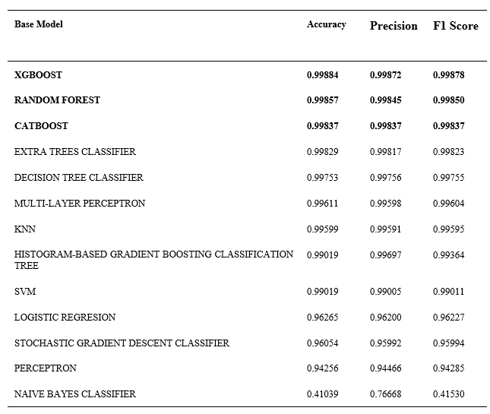
OUTPUT FOR BASE CLASSIFIER SELECTION

Slide 16
OUTPUT FOR BASE-CLASSIFIERS

Slide 17
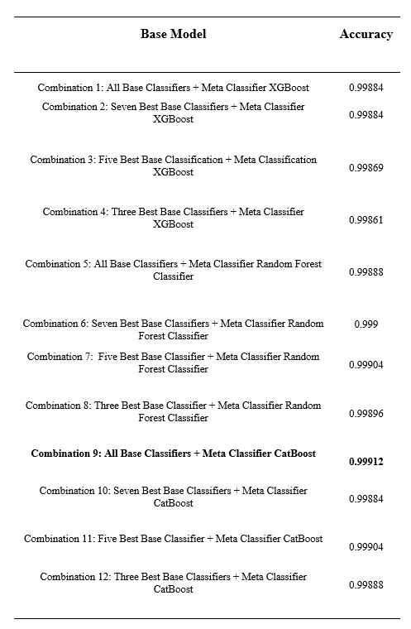
OUTPUT FOR COMBINATION STRATEGY

Slide 19
CONCLUSION
In conclusion, this study demonstrates the crucial role of network intrusion detection in network development and network protection, especially considering that networks are prone to attack via numerous cybercriminals. By the usage of machine learning techniques that leverage the power of meta-learners and records received from different machine learning algorithms, the goal is to enhance the accuracy of network intrusion detection with the help of ensemble learning.
A comprehensive assessment of the study using the NSL-KDD dataset focuses on extracting information from traffic data to detect network attacks. Several network intrusion detection algorithms had been extensively evaluated, such as Gradient Boosting Classification Tree, XGBoost, CatBoost, Random Forest and others. The results had been clearly promising. The three best base-classifiers have been identified and used as meta-classifiers, improving the accuracy of the entire model. A remarkable accuracy of 99.91% was achieved with the use of a combination of All base-classifiers and the CatBoost meta-classifier. Hence, it can be concluded that implementing stacking classifiers has overall improved the accuracy of the CatBoost model from 0.9986 to 0.9991, that is a tremendous improvement and exceeds the accuracy of 0.9987 and 0.9986 for XGBoost and Random Forest classification. Another trend noticed turned into that the best base-classifier need not be the most suitable meta-classifier for the stacked ensemble model. This result demonstrates the potential of meta-learning to improve network intrusion detection systems.

Slide 20
REFERENCES
[1] Zoppi, Tommaso, Mohamad Gharib, Muhammad Atif, and Andrea Bondavalli. "Meta-learning to improve unsupervised intrusion detection in cyber-physical systems." ACM Transactions on Cyber-Physical Systems (TCPS) 5, no. 4 (2021): 1-27.
[2] Olasehinde, Olayemi Oladimeji, Olanrewaju Victor Johnson, and Olufunke Catherine Olayemi. "Evaluation of selected meta learning algorithms for the prediction improvement of network intrusion detection system." In 2020 International Conference in Mathematics, Computer Engineering and Computer Science (ICMCECS), pp. 1-7. IEEE, 2020.
[3] Fan, Kaisheng, Weizhe Zhang, Guangrui Liu, and Hui He. "FMSA: a meta-learning framework-based fast model stealing attack technique against intelligent network intrusion detection systems." Cybersecurity 6, no. 1 (2023): 35.
[4] Shafieian, Saeed, and Mohammad Zulkernine. "Multi-layer stacking ensemble learners for low footprint network intrusion detection." Complex & Intelligent Systems 9, no. 4 (2023): 3787-3799.
[5] Rihan, Shaza Dawood Ahmed, Mohammed Anbar, and Basim Ahmad Alabsi. "Meta-Learner-Based Approach for Detecting Attacks on Internet of Things Networks." Sensors 23, no. 19 (2023): 8191.
[6] Rao, Cheruku Poorna Venkata Srinivasa, Rudrarapu Bhavani, Narala Indhumathi, and Gedela Raviteja. "EL-ID-BID: Ensemble Stacking-Based Intruder Detection in BoT-IoT Data." In International Conference On Innovative Computing And Communication, pp. 821-836. Singapore: Springer Nature Singapore, 2023.
[7] Sarkar, Arindam, Hanjabam Saratchandra Sharma, and Moirangthem Marjit Singh. "A supervised machine learning-based solution for efficient network intrusion detection using ensemble learning based on hyperparameter optimization." International Journal of Information Technology 15, no. 1 (2023): 423-434.
[8] Azimjonov, Jahongir, and Taehong Kim. "Stochastic gradient descent classifier-based lightweight intrusion detection systems using the efficient feature subsets of datasets." Expert Systems with Applications 237 (2024): 121493.

Slide 21
REFERENCES
[9] Sudqi Khater, Belal, Ainuddin Wahid Bin Abdul Wahab, Mohd Yamani Idna Bin Idris, Mohammed Abdulla Hussain, and Ashraf Ahmed Ibrahim. "A lightweight perceptron-based intrusion detection system for fog computing." applied sciences 9, no. 1 (2019): 178.
[10] Mukherjee, Saurabh, and Neelam Sharma. "Intrusion detection using naive Bayes classifier with feature reduction." Procedia Technology 4 (2012): 119-128.
[11] Sindhu, Siva S. Sivatha, Suryakumar Geetha, and Arputharaj Kannan. "Decision tree based light weight intrusion detection using a wrapper approach." Expert Systems with applications 39, no. 1 (2012): 129-141.
[12] Farnaaz, Nabila, and M. A. Jabbar. "Random forest modeling for network intrusion detection system." Procedia Computer Science 89 (2016): 213-217.
[13] Dhaliwal, Sukhpreet Singh, Abdullah-Al Nahid, and Robert Abbas. "Effective intrusion detection system using XGBoost." Information 9, no. 7 (2018): 149.
[14] Kharwar, Ankit Rajeshkumar, and Devendra V. Thakor. "An ensemble approach for feature selection and classification in intrusion detection using extra-tree algorithm." International Journal of Information Security and Privacy (IJISP) 16, no. 1 (2022): 1-21.
[15] Ghanem, Waheed AHM, and Aman Jantan. "A new approach for intrusion detection system based on training multilayer perceptron by using enhanced Bat algorithm." Neural Computing and Applications 32 (2020): 11665-11698.
[16] Subba, Basant, Santosh Biswas, and Sushanta Karmakar. "Intrusion detection systems using linear discriminant analysis and logistic regression." In 2015 Annual IEEE India Conference (INDICON), pp. 1-6. IEEE, 2015.

Slide 22
REFERENCES
[17] Guryanov, Aleksei. "Histogram-based algorithm for building gradient boosting ensembles of piecewise linear decision trees." In Analysis of Images, Social Networks and Texts: 8th International Conference, AIST 2019, Kazan, Russia, July 17–19, 2019, Revised Selected Papers 8, pp. 39-50. Springer International Publishing, 2019.
[18] Prokhorenkova, L., Gusev, G., Vorobev, A., Dorogush, A. V., & Gulin, A. (2018). CatBoost: unbiased boosting with categorical features. Advances in neural information processing systems, 31(2018).
[19] Mohammadi, Mokhtar, Tarik A. Rashid, Sarkhel H. Taher Karim, Adil Hussain Mohammed Aldalwie, Quan Thanh Tho, Moazam Bidaki, Amir Masoud Rahmani, and Mehdi Hosseinzadeh. "A comprehensive survey and taxonomy of the SVM-based intrusion detection systems." Journal of Network and Computer Applications 178 (2021): 102983.
[20] Li, Wenchao, Ping Yi, Yue Wu, Li Pan, and Jianhua Li. "A new intrusion detection system based on KNN classification algorithm in wireless sensor network." Journal of Electrical and Computer Engineering 2014 (2014).
[21] Jiang, W., Chen, Z., Xiang, Y., Shao, D., Ma, L., & Zhang, J. (2019). SSEM: A novel self-adaptive stacking ensemble model for classification. IEEE Access, 7, 120337-120349.

Slide 23
THANK
YOU

